Slide 1
Discrete Mathematics
Xiaowei Yang
School of Software Engineering
South China University of Technology

Slide 2
Rules of Inference
Section 1.5

Slide 3
Contents
1
Rules of Inference
2
Valid Argument, Resolution and Fallacies
3
Rules of Inference for Quantified Statement
4
Method of Proving Theorems
5
Exercise

Slide 4
Rules of Inference

Slide 5
Some Terminologies
A theorem is a statement that can be shown to be true.
A proof is that a sequence of statements that form an argument so that the theorem is true.
Axioms are the underlying assumptions about mathematical structures.
Postulates are hypotheses of the theorem to be proved.

Slide 6
Some Terminologies
Fallacies are some forms of incorrect reasoning, which will help clarity that makes a correct proof.
A Lemma is a simple theorem used in the proof of other theorems.
A corollary is proposition that can be established directly from a theorem that has been proved.
A conjecture is a statement whose truth value is unknown.

Slide 7
Inference Rules - General Form
An Inference Rule is
  A pattern establishing that if we know that a set of premisses are all true, then we can deduce that a certain conclusion statement is true.
premiss 1
premiss 2 …
∴ conclusion “∴” means “therefore”

Slide 8
A Simple Example
“If it snows today, then we will go skiing”
“it is snowing today” hypothesis
If hypothesis is true, the conclusion that “we will go skiing” is true.
p Rule of modus ponens假言推论
p→q
∴q

Slide 9
Some Inference Rules for propositional logic
p Rule of Addition
∴ p∨q
p∧q Rule of Simplification
∴ p
p Rule of Conjunction
q
∴ p∧q

Slide 10
Modus Ponens & Tollens
p Rule of modus ponens
p→q
∴q
¬q
p→q Rule of modus tollens
∴¬p
“the mode of
affirming”
“the mode of denying”

Slide 11
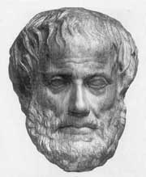
Syllogism Inference Rules
p→q Rule of hypothetical
q→r syllogism [a.k.a. transitivity]
∴p→r
假言三段论
p ∨ q Rule of disjunctive
¬p syllogism
∴ q
析取三段论
Aristotle
(ca. 384-322 B.C.)
Notes:
Many valid inference rules were first described by Aristotle. He called these patterns of argument “syllogisms.”

Slide 12
p ∨ q Rule of Resolution
¬p ∨ r
∴ q ∨ r
[(p ∨ q) ∧ (¬p ∨ r )] → (q ∨ r) Tautology

Slide 13
Valid Arguments
An argument form is called valid if whenever all the hypotheses are true, the conclusion is also true.
( p1 ∧ p2 ∧ … ∧ pn ) → q is True
p1 , p2 , … , pn can lead to a correct conclusion.
( p1 ∧ p2 ∧ … ∧ pn ) ⇒ q

Slide 14
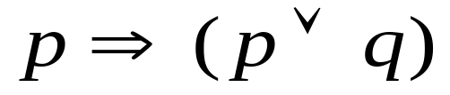

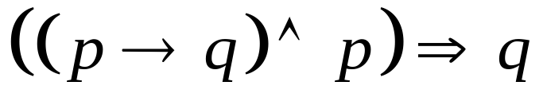
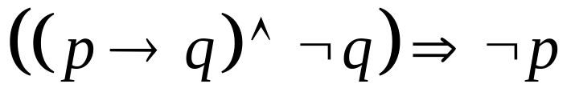
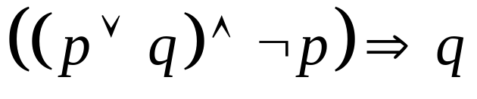
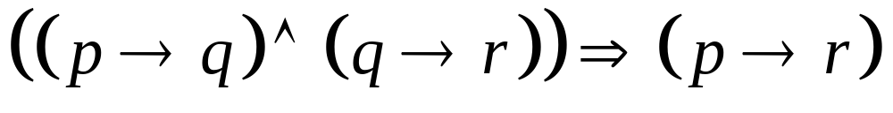
(1) 附加
(2) 化简
(3) 假言推理
(4) 拒取式
(5) 析取三段论
(6) 假言三段论

Slide 15
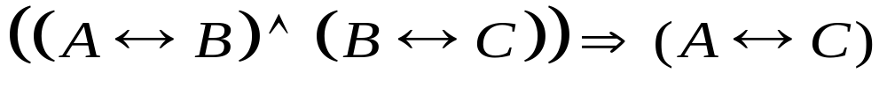
(7) 等价三段论
(8) 构造性二难
(9) 破坏性二难
(A → B) ∧(C → D) ∧(¬B∨¬D) ⇒(¬A∨¬C)

Slide 16
Valid Argument, Resolution and Fallacies

Slide 17
Example 6
“It is sunny this afternoon” p
“it is colder than yesterday” q
“We will go swimming” r
“We will take a canoe trip” s
“We will be home by sunset” t
Hypotheses
¬p ∧ q r → p ¬r → s s→ t

Slide 18
Argument
Step
1. ¬p ∧ q
2. ¬p
3. r → p
4. ¬r
5. ¬r → s
6. s
7. s→ t
8. t
Reason
Hypothesis
Simplification using Step 1
Hypothesis
Modus tollens using 2-3
Hypothesis
Modus tollens using 4-5
Hypothesis
Modus tollens using 6-7

Slide 19
Example 7
“You send me an e-mail message” p
“I will finish writing the program” q
“I will go to sleep early” r
“I will wake up feeling refreshed” s
p → q ¬p → r r → s

Slide 20
Argument
Step
1. p → q
2. ¬q → ¬p
3. ¬p → r
4. ¬q → r
5. r → s
6. ¬q → s
Reason
Hypothesis
Contrapositive of Step 1
Hypothesis
Hypothetical syllogim using 2-3
Hypotheses
Hypothetical syllogim using 4-5

Slide 21
Resolution
Computer programs have been developed to automate the task of reasoning and proving theorem.
The resolution is used for the programs as a rule of inference.
The resolution is based on the tautology
(( p ∨ q ) ∧ ( ¬ p ∨ r )) → ( q ∨ r )

Slide 22
Resolution
(( p ∨ q ) ∧ ( ¬ p ∨ r )) → ( q ∨ r )
( q ∨ r ) is called the resolvent.
Let r = q ( p ∨ q ) ∧ ( ¬ p ∨ q ) → q
Let r = F ( p ∨ q ) ∧ ( ¬ p ) → q
which is the tautology on which the rule of disjunctive syllogism is based.

Slide 23
Example 8
“It is snowing” p
“Jasmine is skiing” q
“Bart is playing hockey” r
Hypotheses ¬ p ∨ q p ∨ r
((¬ p ∨ q ) ∧ (p ∨ r )) → ( r ∨ q )
r ∨ q is the true conclusion implied by Hypotheses.

Slide 24
Example 9
( p ∧ q ) ∨ r
p ∨ r
q ∨ r
r → s
¬ r ∨ s
( p ∨ r ) ∧ (¬ r ∨ s ) → p ∨ s is tautology

Slide 25
Fallacies
The proposition (( p → q ) ∧ q ) → p is not a tautology, since it is false when p is false and q is true.
This type of incorrect reasoning is called the fallacy of affirming the conclusion.
(( p → q ) ∧ ¬ p ) → ¬ q is not a tautology
when p is false and q is true.
The type of incorrect reasoning is called the fallacy of denying the hypothesis.

Slide 26
Formal Proof Example
Suppose we have the following premises:
“It is not sunny and it is cold.”
“We will swim only if it is sunny.”
“If we do not swim, then we will canoe.”
“If we canoe, then we will be home early.”
Given these premises, prove the theorem
“We will be home early” using inference rules.

Slide 27
Formal Proof Example
It is not sunny and it is cold
We will swim only if it is sunny
If we do not swim, then we will canoe
If we canoe, then we will be home early
∴We will be home early
  sunny = “It is sunny”; cold = “It is cold”;
  swim = “We will swim”;
  canoe = “We will canoe”;
  early = “We will be home early”.

Slide 28
Proof Example cont.
The premises can be written as:
(1) ¬sunny ∧ cold (2) swim → sunny
(3) ¬swim → canoe (4) canoe → early
It is not sunny and it is cold
We will swim only if it is sunny
If we do not swim, then we will canoe
If we canoe, then we will be home early

Slide 29
Proof Example cont.
Step Proved by
1. ¬sunny ∧ cold Premise #1.
2. ¬sunny Simplification of 1.
3. swim→sunny Premise #2.
4. ¬swim Modus Tollens on 2,3.
5. ¬swim→canoe Premise #3.
6. canoe Modus Ponens on 4,5.
7. canoe→early Premise #4.
8. early Modus Ponens on 6,7.

Slide 30




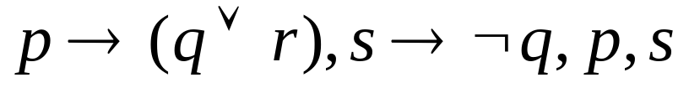
Example in Chinese
写出对应下面推理的证明。
(1) 如果今天是星期一，则要进行英语或离散数学考试。
如果英语老师有会，则不考英语，
今天是星期一，英语老师有会，
所以进行离散数学考试。
解：
：今天是星期一，
：进行英语考试，
：进行离散数学考试，
：英语老师有会。
前提：
结论：

Slide 31
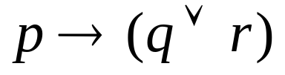



Example in Chinese
前提：
结论：
证明：
①
前提引入
②
前提引入
③
①②假言推理
④
前提引入
⑤
前提引入
⑥
④⑤假言推理
⑦
③⑥析取三段论

Slide 32
Rules of Inference for Quantified Statement

Slide 33
All Inference Rules for Quantifiers
∀x P(x)
∴P(o) (substitute any object o)
P(g) (for g an arbitrary element)
∴∀x P(x)
∃x P(x)
∴P(c) (substitute a new constant c)
P(o) (for any object o)
∴∃x P(x)
Universal instantiation
Universal generalization
Existential instantiation
Existential generalization

Slide 34
Example 12
D(x) denotes “x is in this discrete mathematic class”
C(x) denotes “x has taken a course in computer science”
The premises are ∀x (D(x) → C(x)) and D(Marla)
∀x (D(x) → C(x)) Premise
D(Marla) → C(Marla) Universal instantiation
D(Marla) Premise
C(Marla) Modus Ponens from #2 and #3

Slide 35
Example 13
C(x) denotes “x is in this class”
B(x) denotes “x has read the book”
P(x) denotes “x passed the first exam”
Premise ∃ x (C(x) ∧ ¬ B(x))
∀ x (C(x) → P(x))
Conclusion ∃ x (P(x) ∧ ¬ B(x)) ?

Slide 36
1. ∃ x (C(x) ∧ ¬ B(x)) Premise
2. C(a) ∧ ¬ B(a) Existential instantiation from 1
3. C(a) Simplification from 2
4. ∀ x (C(x) → P(x)) Premise
5. C(a) → P(a) Universal instantiation from 4
6. P(a) Modus pones from 3 and 5
7. ¬ B(a) Simplification from 2
8. P(a) ∧ ¬ B(a) Conjunction from 6 and 7
9. ∃ x (P(x) ∧ ¬ B(x)) Existential generalization from 8

Slide 37
Method of Proving Theorems

Slide 38
Other proof methods for implications
For proving implications p→q, we have:
Direct proof: Assume p is true, and prove q.
Indirect proof: Assume ¬q, and prove ¬p.
(Vacuous proof: Prove ¬p by itself.
Trivial proof: Prove q by itself.)
Proof by cases:
Show (a ∨ b) → q, and (a→q) and (b→q).

Slide 39
Direct Proof Example
Definition: An integer n is called odd iff n=2k+1 for some integer k; n is even iff n=2k for some k.
Theorem: (For all numbers n) If n is an odd integer, then n² is an odd integer.
Proof: If n is odd, then n = 2k+1 for some integer k. Thus, n² = (2k+1)² = 4k² + 4k + 1 = 2(2k² + 2k) + 1. Therefore n² is odd. □
Notes:
The `numbers’ parts of a proof like this can also be proven precisely, for example using the Peano axioms of arithmetic.

Slide 40
Indirect Proof Example (calculus)
Theorem: (For all integers n)
If 3n+2 is odd, then n is odd.
Proof: Suppose n is even. Then n=2k for some integer k. Then 3n+2 = 3(2k)+2 = 6k+2 = 2(3k+1), which is even (not odd). □

Slide 41
Vacuous and Trivial Proof
p is false
p → q is true according to truth value table
F → T or F → F is true.
“p is false” is called a vacuous proof.
q is true
p → q is true according to truth value table
F → T or T → T is true.
“q is true” is called a trivial proof.

Slide 42
Proofs by Contradiction
Given a proof by contradiction of the theorem “If 3n+2 is odd, then n is odd.”

Slide 43
Proof by Cases
To prove the implication of the form
( p1 ∨ p2 ∨… ∨ pn ) → q
The tautology
[ ( p1 ∨ p2 ∨… ∨ pn ) → q ]
↔ [( p1 → q ) ∧ ( p2 → q ) ∧…∧ ( pn→ q ) ]
p1, p2 ,…, pn can be proved by proving each of the n implications pi→ q , i=1,…,n

Slide 44
Proof by Equivalence
( p ↔ q ) ↔ [ ( p → q ) ∧ ( q → p ) ]
Example 24
The integer n is odd if and only if n^2 is odd.
( p ↔ q ) ↔[( p1 → p2 ) ∧ ( p2 → p3 ) ∧…∧ ( pn→ p1 ) ]
Example 25 Show that these statements are equivalent p1 : n is an even integer.
p2 : n-1 is an odd integer.
p3 : n^2 is an even integer.

Slide 45
Others about Theorem Proof

Slide 46
Theorem and Quantifiers
Existence Proofs
Uniqueness Proofs
Counterexample

Slide 47
Exercise

Slide 48


Complete the following proof。
(1) Premises：
Conclusion：
(2) Premises：
Conclusion：

Slide 49
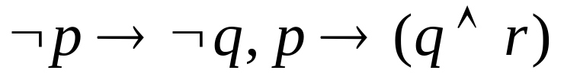

Exercise in Chinese
(3) 如果乙不参加篮球赛，那么甲就不参加；
如果乙参加篮球赛，那么甲和丙就参加。
因此，如果甲参加篮球赛，那么丙就参加。
解：
：乙参加篮球赛，
：甲参加篮球赛，
：丙参加篮球赛。
前提：
结论：

Slide 50


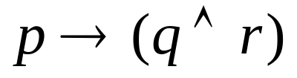


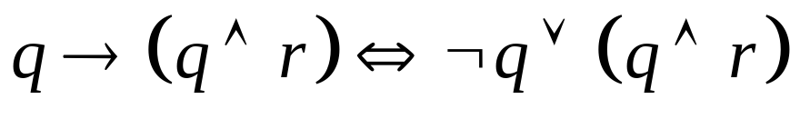
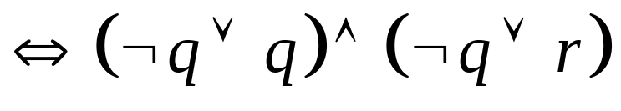

Exercise in Chinese
前提：
结论：
证明：
①
前提引入
②
①置换规则
③
前提引入
④
②③假言三段论
⑤
④置换规则
(
)

Slide 51
Exercise in Chinese
如果他是计算机系本科生或者是计算机系研究生，那么他一定学过DELPHI语言而且学过C++语言。只要他学过DELPHI语言或者C++语言，那么他就会编程序。因此如果他是计算机系本科生，那么他就会编程序。请用命题逻辑推理方法，证明该推理的有效结论。

Slide 52
Exercise in Chinese
令p：他是计算机系本科生 q：他是计算机系研究生
r：他学过DELPHI语言 s:他学过C++语言 t:他会编程序
前提：(p∨q)→(r∧s),(r∨s)→t
结论：p→t
证：①p P(附加前提)
②p∨q ①
③(p∨q)→(r∧s) P(前提引入)
④r∧s ②③
⑤r ④
⑥r∨s ⑤
⑦(r∨s)→t P(前提引入)
⑧t ⑤⑥

Slide 53
Questions after School
A said “B lies”
B said “C lies”
C said “Both A and B lie”
Who lie indeed?

Slide 54
P58
7 c

Slide 55
End of the Section 1.5

